Slide 1
LACNIC UPDATE
RIPE 67
OCTOBER 2013
Prepared by: Elisa Peirano
elisa@lacnic.net
Hostmaster
Presented by: Luisa Villa
luisa@lacnic.net
Customer Manager

Slide 2
Topics
Membership Update
Resources Update
IPv4 & IPv6 Allocations/Assignments
Resource Certification (RPKI)
Frida Program
Ayitic
Certiv6
RIPE Atlas Ambassador
Previous & Upcoming Meetings

Slide 3
Membership Update
Notes:
Actualizada al 1/10/2013

Slide 4
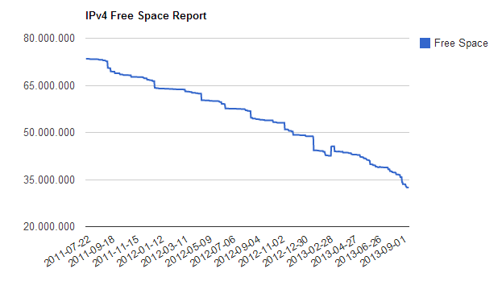
Resources Update
IPv4 Pool Status (Oct 16th, 2013)
31,609,600 Free IPv4 addresses (1,88/8s)
http://www.lacnic.net/en/web/lacnic/reporte-direcciones-ipv4

Slide 5
IPv4 Allocated & Assigned in /8
September 2012 – September 2013

Slide 6
IPv4 & IPv6 Allocated/Assigned
Notes:
Alloc y assign ipv4+ipv6

Slide 7
IPv6 Allocated & Assigned
LACNIC Members - 3212
LACNIC Members with IPv6 alloc&assig - 1847
Percentage - 57,50 %
Alloc & Assig IPv6 in 2012 - 578
Alloc & Assig IPv6 in 2013 (so far) - 483
Notes:
actualizado

Slide 8
Resource Certification
Signed Prefix Count
IPv4 Space Covered by ROAs
(/24 Blocks)
Source: http://www.labs.lacnic.net/~rpki/rpki-evolution-report_EN.txt
Notes:
Actualizada al dia 17/09/2013

Slide 9
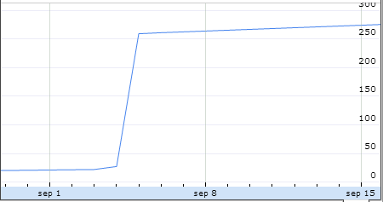
RPKI deployment in NAP.ec
Number of prefixes signed: 277 after the event in NAP.ec

Slide 10
Frida Program
An initiative of LACNIC.
Three sides:
- Frida Awards+ (For Existing Projects)
http://programafrida.net/awards
- Frida Grants (For Further Research).
http://programafrida.net/grants
- Frida Escalating Projects (Contribute to the growth and replication of projects in the region)
Since February 2012 Frida is part of the Seed Alliance
Joint initiative of ISIF.asia (APNIC Program), Frida (LACNIC Program) and FIRE (AfriNIC Program) for extended efforts.
http://programafrida.net/seed_alliance

Slide 11
Ayitic Program
http://www.ayitic.net/en/index.html
Designed specifically for Haiti’s needs.
Created by LACNIC to directly contribute to building capacity for Haitian technicians and professionals in the field of ICTs.
To build capacity and expand knowledge networks.
2013 Workshop edition:
Port-au-Prince, August 12th -16th
100 attendees.
Notes:
No hay resultados medidos todavia quizas el lunes

Slide 12
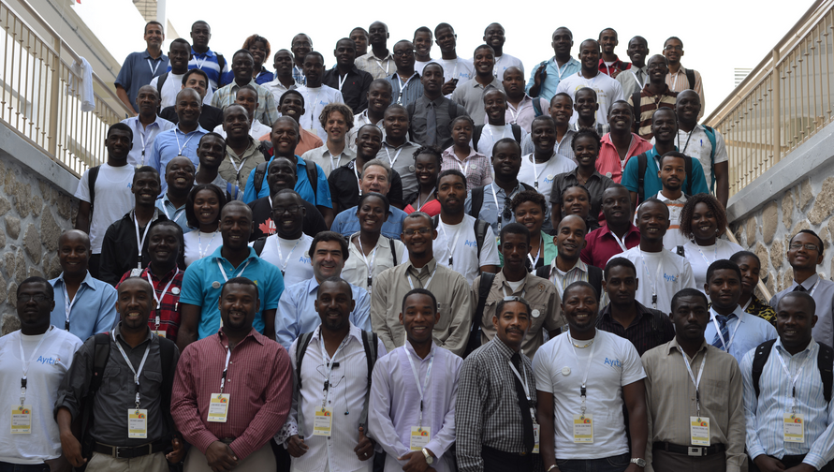
http://www.ayitic.net

Slide 13
LACNIC developed Certiv6 to promote the adoption and awareness of IPv6 to a new public.
It is a methodology to be used by software testing and Internet technology experts to certify that a software application runs properly over the IPv6 protocol.
Launchings:
Uruguay – April 16th
Colombia – May 10th
Argentina – September 4th
For more information visit: www.certiv6.com or contact: info@certiv6.com

Slide 14
RIPE Atlas Ambassador
3 Venezuela
1 Trinidad
1 Aruba
More to be distributed in our next meeting in Curaçao.

Slide 15
Previous Meetings
LACNIC 19 (5th- 10th May, 2013)
Medellin, Colombia.
LACTLD
Public Policy Forum
3 proposals
1 reached consensus
LAC-2012-13v2 Modifying requirements for ASO AC nominees – Already in LACNIC´s Policy Manual
ASO/AC Member Election
Jorge Villa, from Cuba was elected

Slide 16
Upcoming Meetings
LACNIC 20
Committed to the future of the Internet
Curaçao
28/10 – 01/11

Slide 17
Upcoming Meetings
LACNOG 2013
Great Speakers and Tutorials
IPv6, DNSSEC, RPKI, Internet Governance and more…
Policy Forum
5 proposals to be discussed
LAC-2012-01v3 Eliminate the use of the term "dial-up“
(A workgroup has been implemented to review this proposal)
LAC-2012-08v3 Inter-RIR IPv4 Address Transfers
LAC-2013-01 Publishing information on reassigned IP address blocks via FTP
LAC-2013-02 Principles Governing the distribution of Number Resources
LAC-2013-03 Adapting the allocation / assignment policy for IPv4 exhaustion

