Slide 2
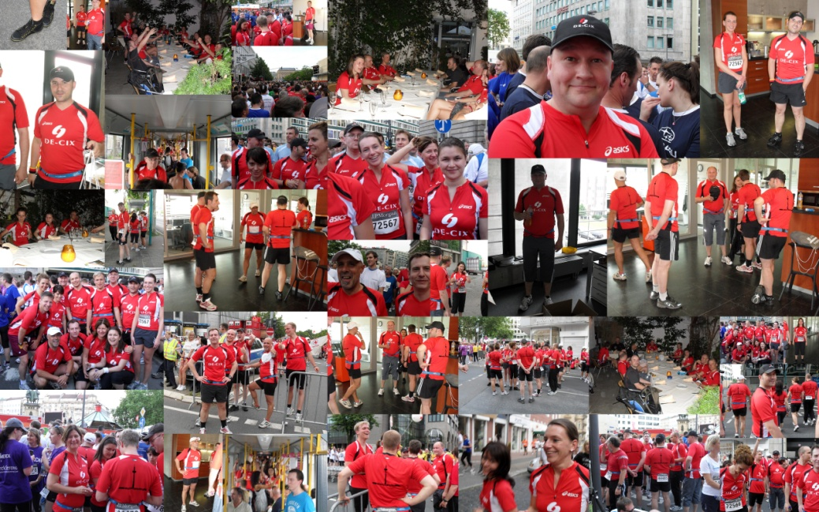
DE-CIX Apollon Migration Update
2013-10-17
RIPE67 Athens
Wolfgang Tremmel
wolfgang.tremmel@de-cix.net

Slide 3
The story so far….
DE-CIX about to replace its production infrastructure
From Force10 switches to Alcatel-Lucent routers
From pure layer 2 switching to MPLS/VPLS routing
From passive to active optical network layer
Details of the new architecture were presented at RIPE66 Dublin
This is an update about the current state of the migration

Slide 4
Artemis
New DE-CIX internal tool
Technical customer database
provisioning
configuration
Completely written from scratch
19203 lines of code so far
200 man days development time
Replaces a lot of over-the-years-grown scripts

Slide 5
DE-CIX Apollon – Migration Preparation
Database cleanup – comparing reality with database
Kickoff meeting with datacenter operators
Working closely with the datacenter operators to find the best strategy for each DE-CIX site
Precabling new hardware
On some sites we needed to replace lots of connections to customer
Big “Thank You” to Interxion, Telecity and Level3 for their effort and professionality to help us make these migrations happen

Slide 6
DE-CIX Apollon – Migration Preparation - Customers
Customers are individually notified at least two weeks in advance
And again on the day before the migration
Technical list is of course also notified
For one site we needed a LOA from each customer, as all fibres had to be replaced.
Directly after each individual move the migrated customer is again notified

Slide 7
DE-CIX Apollon – State of the migration
Three migration windows done
94 customers with 237 ports are already migrated
Migrations happen on Wednesdays, starting at midnight
Last migration will be on 4th of December

Slide 8
Migration – how does it work?
Team of four
Datacenter engineer on site moving fibres
DE-CIX engineer in office doing configuration
DE-CIX customer supporter in office updating customers
Standby DE-CIX engineer on site for special situations
All connected via a phone bridge
All having a view on the router logfile to monitor status

Slide 9
Migration – how do we do it?
Onsite meeting in the week before the migration
On the day of the migration:
Be at the office at 23:30
Start the phone bridge
Start migrating customers at midnight
Until finished – with a 10 minute break every hour
Write a report and do a handover to the day team

Slide 10
Migrating customers
Pull out fibre on the old platform
Plug fibre into new DE-CIX Apollon platform
Check light level – clean if necessary
Check ping / packet loss
Activate port
Notify customer
Takes about 3 minutes
EtherChannels: Move half of ports, then test and activate

Slide 11
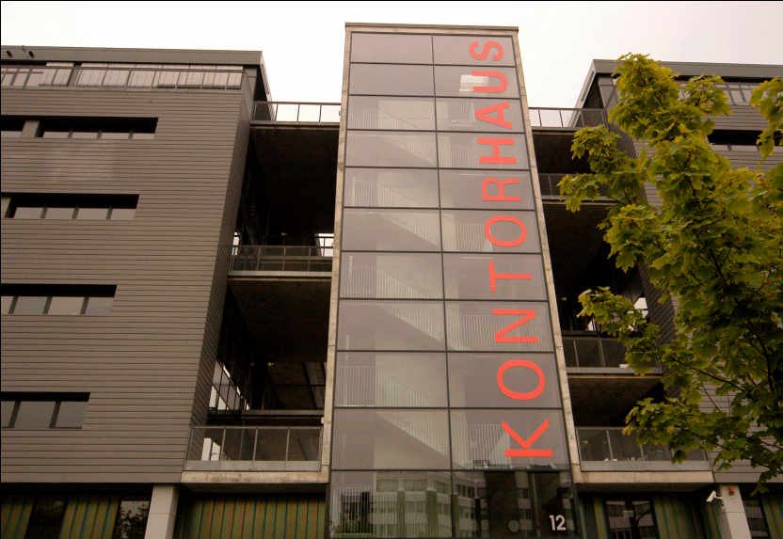
Thank you!
Join DE-CIX now!
DE-CIX Competence Center
Lindleystrasse 12
60314 Frankfurt/Germany
Phone +49 69 1730 902 - 0
info@de-cix.net
DE-CIX Competence Center @ Kontorhaus Building
Frankfurt Osthafen (Docklands)

