Slide 1
IPv6 Source Addresses
What Could Possibly Go Wrong?
Jen Linkova, furry@google.com

Slide 2
Logging all IPv6 packets from reserved/invalid sources entering Google network from Internet
Collecting the data for a few days
Data Set:
2011:
1.1M packets
32.5K Unique IPs
2013:
15M packets
476K Unique IPs

Slide 5
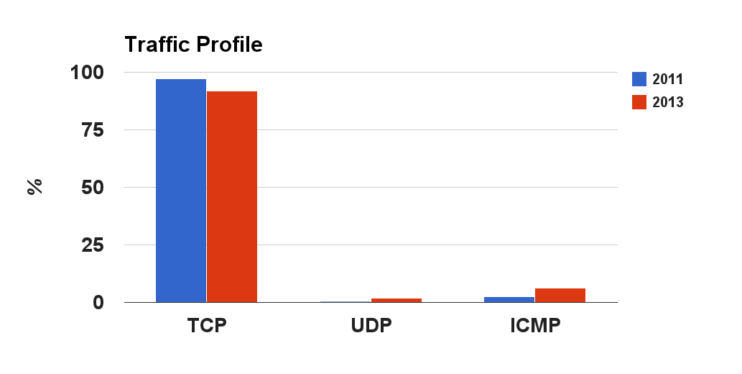
1.9
6.3
0.4
2.5

Slide 6
ICMP Traffic Profile
Users’ Traffic
Echo Requests
Infrastructure
Time Exceeded
Packet Too Big
Destination Unreachable
> 99% - ‘Address Unreachable’
* Neighbor Discovery Redirects

Slide 7
Link-Local Unicast
fe80::/10

Slide 8
 | Packets (% of all packets) | Unique Address |  | Vendors (OUI)
 |  | Total | MAC48 based (*) | Known | Unknown
2011 | 26198 (2%) | 156 | 129 (82%) | 24 | 2
2013 | 11676 (0.08%) | 35 | 32 (91%) | 18 | 1
* “Based on MAC-48”: “U/L bit is set and “FF:FE octets present”.
Other addresses look like privacy extensions or based on locally administered MAC-48.

Slide 9
Traffic Profile
Majority of traffic is TCP (~90%)
Non-TCP traffic:
2011: mix of ICMP
destination unreachable
packet too big
time exceeded
ND redirects
2013: traffic from TWO routers only
ND redirects to Google frontends IPs.

Slide 10
Neighbor Discovery Redirects
RFC 4861 - Neighbor Discovery for IP version 6 (IPv6)
Source Address: MUST be the link-local address assigned to the interface from which this message is sent.Destination Address: The Source Address of the packet that triggered the redirect - MUST identify a neighbor
1
Data packet:
Source: Google frontend IP
Destination: customer’s IP
INTERNET
Googe Network
THE ROUTER
Edge Router
Frontend
2
ND Redirect:
Source: the router link-local IP
Destination: Google frontend IP
Notes:
HUAWEI TECHNOLOGIES CO.,LTD
and
AVM GmbH

Slide 11
How Did They Get There?
None of those packets are from devices directly connected to Google routers
Packets with link-local source came from Internet - successfully routed
RFC4007 “IPv6 Scoped Address Architecture”
Section 9, “Forwarding”:
If transmitting the packet on the chosen next-hop interface would cause the packet to leave the zone of the source address, i.e., cross a zone boundary of the scope of the source address, then the packet is discarded.

Slide 12
Unique Local Unicast Addresses
ULA
fc00::/7

Slide 13
 | Packets (% of total packets analyzed) | Prefixes |  |  | Addresses |  | IPs/prefix (avg)
 |  | Total count | Locally Assigned | Invalid ULAs a.k.a ‘globally assigned’ | Total count (% of total packets) | IEEE MAC48 based
2011 | 271056 (24%) | 652 | 644 (99%) | 8 (1%) | 2063 (6.0 %) | 88 (4.27%) | ~3
2013 | 7125395 (48.0 %) | 15545 | 15518 (99.8%) | 27 (0.2%) | 108920 (23%) | 1452 (1.3%) | ~7
IPv6 is hard: There is some confusion between fc00::/7, fc::/7 and fc0::/7!

Slide 14
‘U’ Stands For ‘Unique’...Really?
What is the proper way to detect non-random GID?
highest octet is ‘0’ or ‘1’ OR
hex representation contains [a-f] or [0-9] only OR
hex representation contains 3 or less different symbols (excl. ‘:’)
two octets are ‘0’
Non-Random Prefixes Top List:
fc00::/48
fd00::/48
fdfd:cafe:cafe::/48
Non-random ULA prefixes:
2011: 2.8%
2013: 0.7%
Notes:
Example of non-random: fd1f:ff23:f356::/48

Slide 15
Site Local Addresses
fec0::/10
(Deprecated Since 2004)

Slide 16
 | Addresses (% of all unique IPs) | Prefixes | Packets (% of total packets) | Traffic Profile
 |  |  |  | TCP | ICMP Dest. Unreachable | ICMP Time Exceeded | UDP
2011 | 16 (0.05%) | 8 | 10497 (1%) | 64% | 1% | 35% | < 0.1%
2013 | 205 (0.04%) | 21 | 55963 (0.4%) | 40% | 40% | 20% | < 0.1%
Traffic profile is different from ULA

Slide 17
Anomalies

Slide 18
6Bone Addresses: 3ffe::/16 and 5f00::/8
~1% of all logged packets: 3ffe:831f::/32
Was used by Teredo on Windows machines
100% of traffic is ICMP Echo Requests
0.01% of all logged packets are from actual 6bone block
7 IP addresses detected
100% of traffic is TCP
Notes:
Source are different in 2011 and 2013

Slide 19
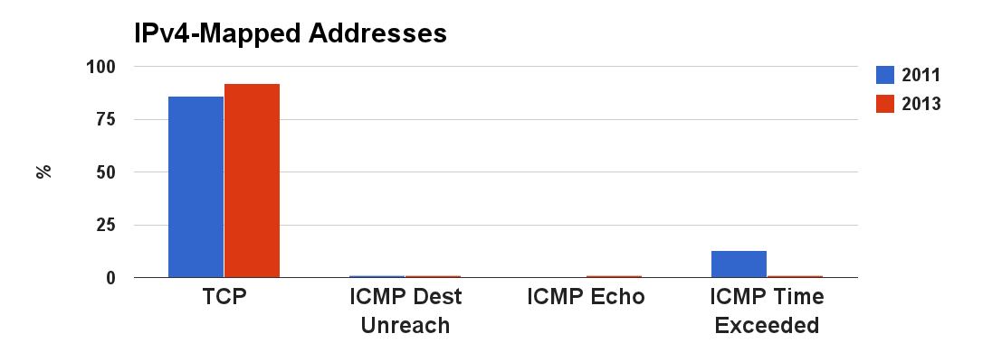
IPv4-Mapped ::FFFF:0:0/96
Used in the IPv6 basic API to denote IPv4 addresses
Should NOT appear on the wire
2011/2013 - ~0.1% of analyzed traffic
86
96
13
1
1
0
1
1
Notes:
should appear as source at all normally. However: http://technet.microsoft.com/en-us/library/cc727992(v=ws.10).aspx
No particular pattern in encoded Ipv4 addresses - looks pretty much random.

Slide 20
IPv4-Compatible ::/96
Deprecated since 2006
Should NOT appear on the wire
2011/2013 - ~2% of analyzed traffic
Most of encoded IPs are private
Mostly (97%): ICMP Destination Unreachable
Notes:
should appear as source at all normally. However: http://technet.microsoft.com/en-us/library/cc727992(v=ws.10).aspx
No particular pattern in encoded Ipv4 addresses - looks pretty much random.

Slide 21
::/64 Subnet
Very few packets from
::/1
:: (unspecified)
Mystery Traffic:
Interface ID: 64 non-zero bits, NOT based on MAC48

Slide 22
What We DID NOT See
Multicast Sources
Very little traffic from random blocks
addresses like ‘a:a:a:a:a:a:a:a’ are popular

Slide 23
Summary
Address selection is still broken
Things are getting better
No explanation for some mystery packets
Scoped Address Architecture is ignored ;(
..let alone BCP38…:-((

Slide 24
QUESTIONS?

