Slide 1
Building and Maintaining the Nagios Ecosystem
Scott Wilkerson
swilkerson@nagios.com

Slide 2
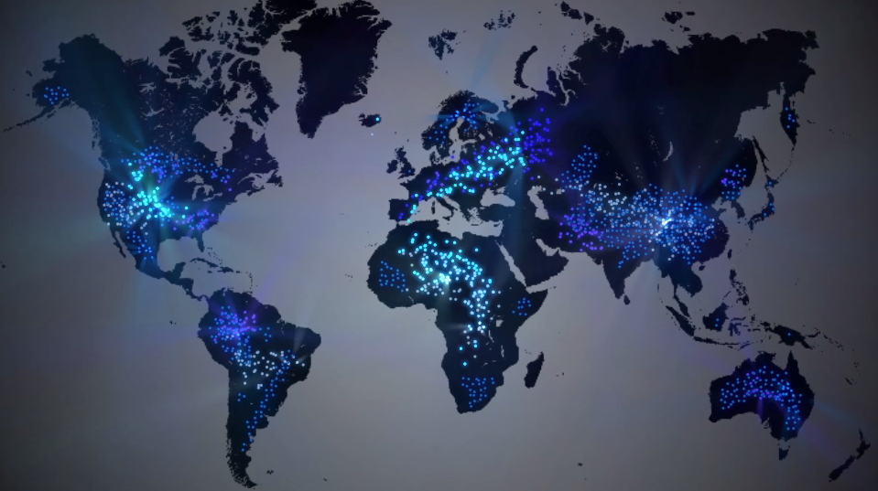
Topics Covered
About Me
What is Nagios?
Nagios History
Commercial Nagios
Nagios News
The Nagios Ecosystem
Nagios Challenges
How to Support Nagios
Q & A / Ask Nagios!
Notes:
How many people believe their organization uses Nagios?

Slide 3
About Me
IT Manager @ Nagios Enterprises
Nagios Team Member Since 2011
Nearly 20 Years in IT Industry
12 Years in Senior Management
Ran an ISP when 28.8k Modems were the Rage…
Degree in Computer Programming
Some Development at Nagios
Primary Role - Oversee IT Operations
Developers / Support Staff

Slide 4
What is Nagios?
Nagios was Synonymous with Nagios Core
Nagios is a Brand / Trademark
Covering Numerous IT Related Software Areas
Many Fully Open Source
Nagios Core / NDOutils / NRPE / NSCA /NSTI / NCPA / etc.
Several Commercial Products
Nagios XI / Fusion / Incident Manager / Network Analyzer
Over 5.6 Million Source Download Since 2001

Slide 5
Nagios History
Nagios Core First Released in 1999 as NetSaint
by Ethan Galstad
2001 Project Name Changed to Nagios
2007 Nagios Enterprises Founded
2009 Nagios XI Released
Notes:
The decision to go the Open Source route wasn’t taken lightly

Slide 6
Commercial Nagios
Will Commercial Versions of Nagios Affect Open Source Core?
Commercial Version will Likely Enhance Core
Additional Exposure to Nagios Through Marketing Efforts
Additional Addons Which Can Be Used In Core
Additional In-House Resources Available to Start Other Open Source Projects

Slide 7
Nagios News
Nagios Core 4 Released - 9/20/2013
700% Performance Increase Over Nagios 3
Core Workers
Remove Disk I/O Bottleneck
Possibility to Distribute Load to External Workers
Query Handler – Simple Interface to communicate with Nagios Core
Coming Soon! JSON API

Slide 8
Nagios News cont.
Nagios Cross Platform Agent (NCPA)
One Source Base
Many OS’s – Windows/Linux
Nagios Network Analyzer Released
NetFlow Analyzer
Commercial Product Built on Open Source
Search for Next Generation Nagios Stars
http://go.nagios.com/nextgenstars
nextgenstars@nagios.com

Slide 9
The Nagios Ecosystem
Def. Community of Interacting Organisms
Nagios Core Does Nothing Until Extended
Causes Additional Open/Closed Source Projects
Key Addons
NSCA / NRDP / NRPE / NDOutils / NSTI / NCPA
4000+ Projects on http://exchange.nagios.org
Commercial Projects Use Same Philosophy
Extendable
Use Open Source When Possible
Notes:
Insists on being extended
Many can be extended
Few do nothing until extended
No two installations are alike
-Commercial
Extendable and Extensible
Easily integration with one another

Slide 10
Nagios Challenges
Guard The Code
Protect Against Scope Creep
This is where addons / plugins should be used
Patch Review / Testing / Acceptance Process
Protect The Brand / Trademark
Project Begs to be Extended
Changes to Core Could Affect 1000’s of Addons
Misconceptions:
Nagios Enterprises Only Supports Paid Clients
Free Version Could Disappear
Notes:
Guard the code
Regular contributors try to force their agenda
We love community patches, but not all can nor will get applied
Protect The Brand / Trademark

Slide 11
How to Support Nagios Project
Feedback
New Features / Projects / Addons
Report Bugs
Submit Patch
Assist Community Members / Users
http://support.nagios.com/forum/
Financial Support
Send Donation ;-)
Consider Commercial Solutions Built on Open Source
Notes:
Feedback
Ideas Forum
Financial Support was the topic of the BoF session at RIPE 66
How to support?
Donations accepted
However maybe consider Nagios Commercial Solutions Built on Open Source

Slide 12
Question & Answer / Ask Nagios!
New Product Ideas (What would be useful?)
Current Product Feature Improvements
Current Product Feature Additions
Nagios Core
Nagios XI
Nagios Network Analyzer
Nagios Incident Manager

Slide 13
Contact Information
Support
http://support.nagios.com/forum/
Basic Contact Info
Phone: US: 1-888-NAGIOS-1 (1-888-624-4671) International: +1-651-204-9102
Email: sales@nagios.com
Fax: +1-651-204-9103
Mail: Nagios Enterprises, LLC P.O. Box 8154 Saint Paul, MN 55108
Headquarters: 1295 Bandana Blvd N, Suite 165 Saint Paul, MN 55108

