Slide 1
Imprecise Network Monitoring Tools
Brian Nisbet, HEAnet
RIPE67, Athens

Slide 2
Caveats!
Important word here is imprecise
This is a secondary information source at best
People on the Internet are often wrong
Do not go home and turn off other tools!

Slide 3
Imprecise Tools

Slide 4
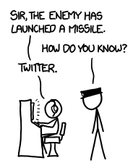
Is This the Future?
xkcd.com

Slide 5
More Imprecise Tools

Slide 6
Is It Someone’s Job?
Many commercial operators have dedicated social media CS teams.
No expectation for NRENs to have them, yet.
Any expectation for either group to have engineering staff hired to check Twitter?

Slide 7
Use Cases - NRENs
Is $VLE down for everyone or just me?
Has the campus lost power or just connectivity?
Has the local computer services dept noticed something they haven’t told you about yet?

Slide 8
Use Cases – Commercial Operators
Routing issues to !Google or !Amazon?
Increased latency?
Unintended consequences of a change?

Slide 9
Configuration Hints
Find relevant official a/cs, follow them
Reactive searches
Don’t just search locally, the Internet is a big place!

Slide 10
Alarm Filtering
Huge amounts of noise, even (especially?) during an incident
Many students complain about having to study, then complain when they can’t
Institution acronyms may well be shared (DCU is a university, a football team & a superhero universe)

Slide 11
brian.nisbet@heanet.ie
@natural20
www.facebook.com/natural20

