Slide 1
ARIN Update
Aaron Hughes
ARIN Board of Trustees

Slide 2
2013 Focus
IPv4 Depletion & IPv6 Uptake
Developing, adapting, and enhancing processes and procedures
IPv4 Count Down Plan
Continuing IPv6 outreach
IPv4 Transfers
Continued development and integration of web-based system (ARIN Online)
Continuing migration from legacy systems by deploying new functionality
RPKI deployment
Continued participation in Internet Governance forums
Notes:
ARIN is continuing to migrate from and retire legacy systems which are difficult and expensive to support by incorporating, and where needed, enhancing functionality within ARIN Online or providing similar functionality elsewhere.

Slide 3
Current IPv4 Inventory
1.74 /8 equivalents
in the pool of
“available addresses”
1.74
~4 /16 equivalents in the “RRH” bucket
(RRH = returned, revoked, held)
1 /10 reserved
For NRPM 4.10 “Dedicated IPv4 block to facilitate IPv6 Deployment”
Notes:
Total inventory is 1.76 “/8” + 4 “/16” + the /10

Slide 4
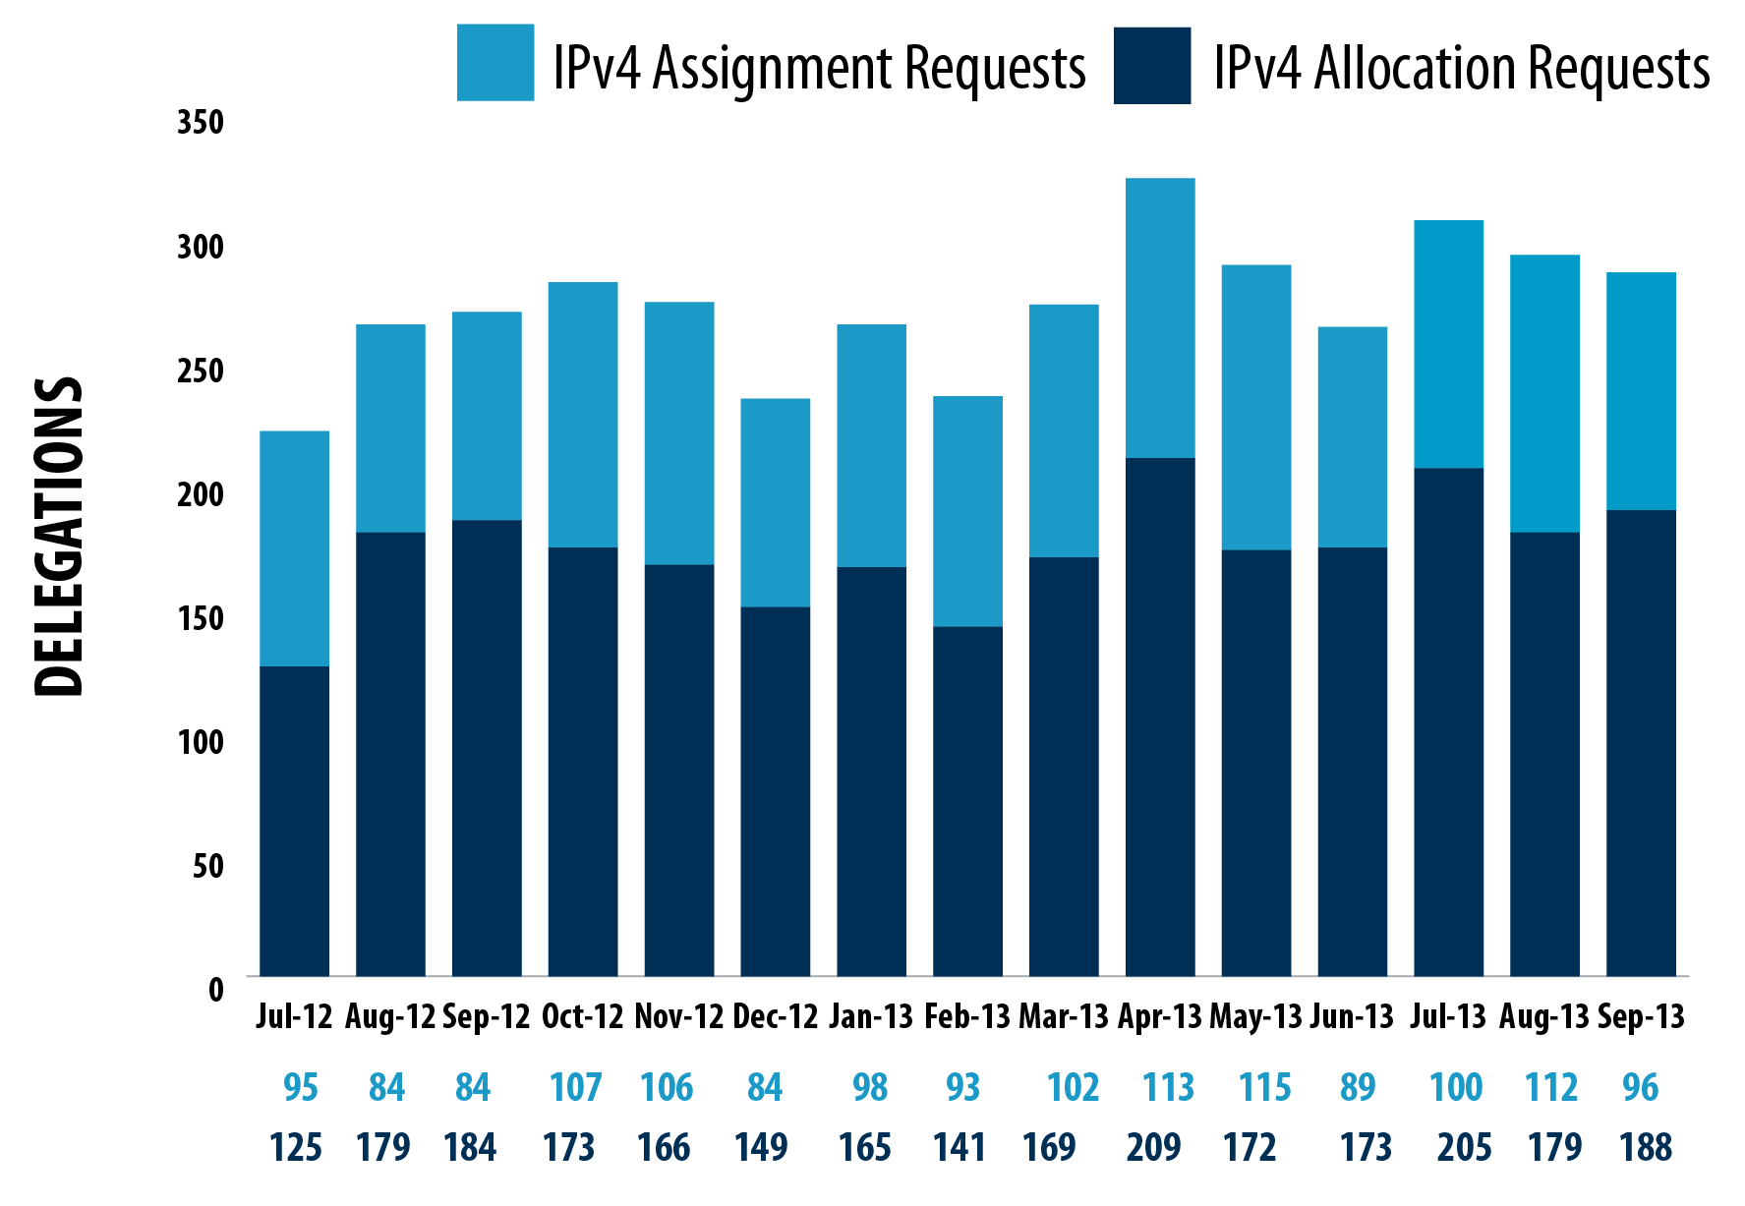
Requests for IPv4 Address Space (past 12 months)

Slide 5
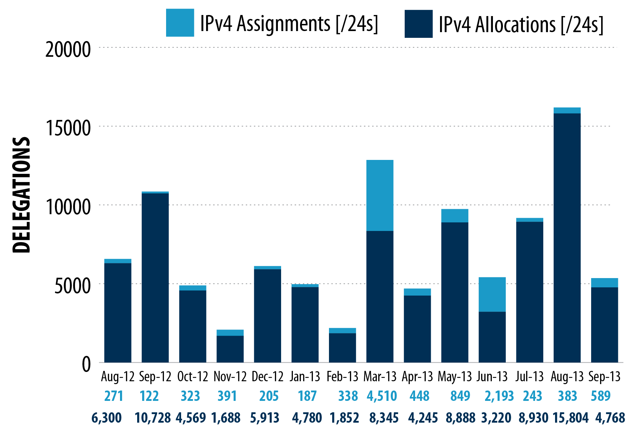
IPv4 Space Issued (past 12 months)

Slide 6
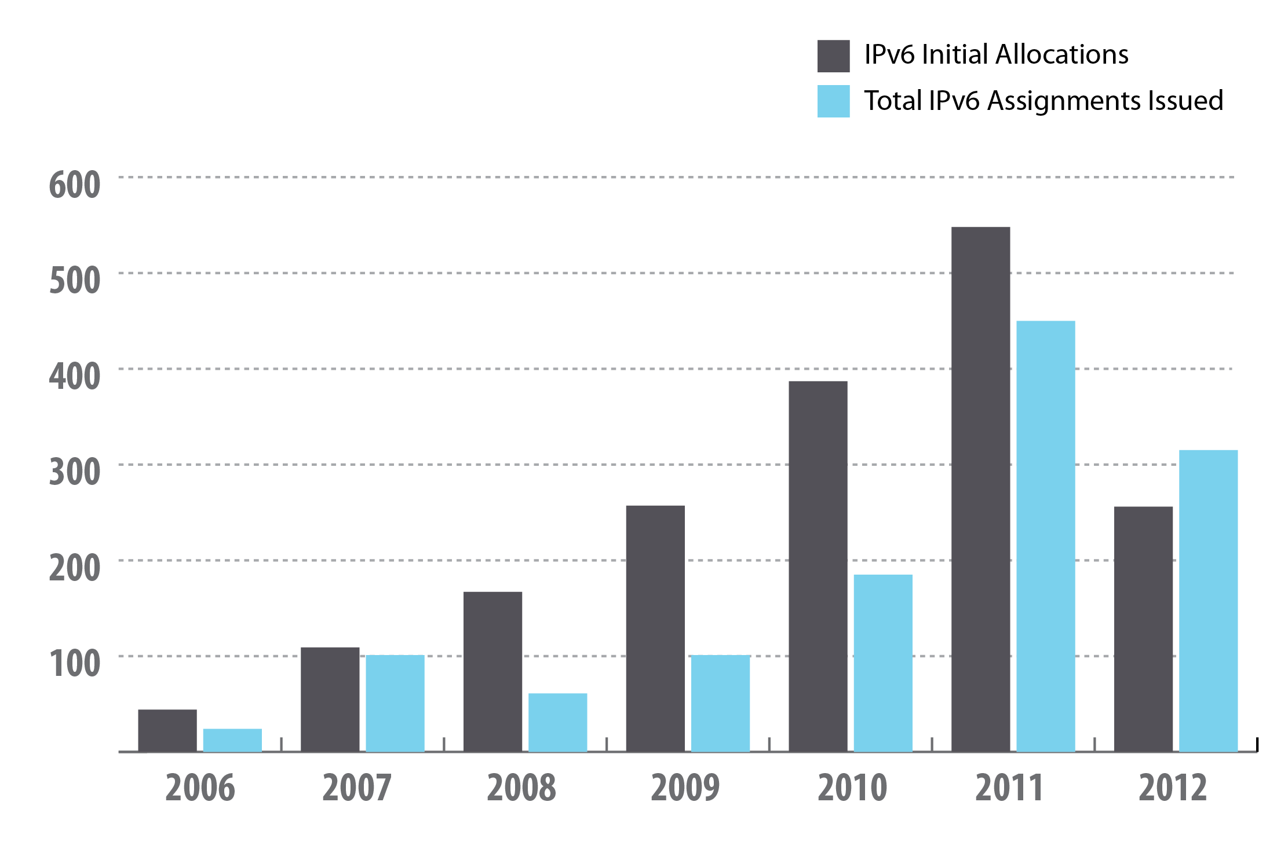
IPv6 Space Issued
Notes:
240 allocations and 187 assignments through August 2013.

Slide 7
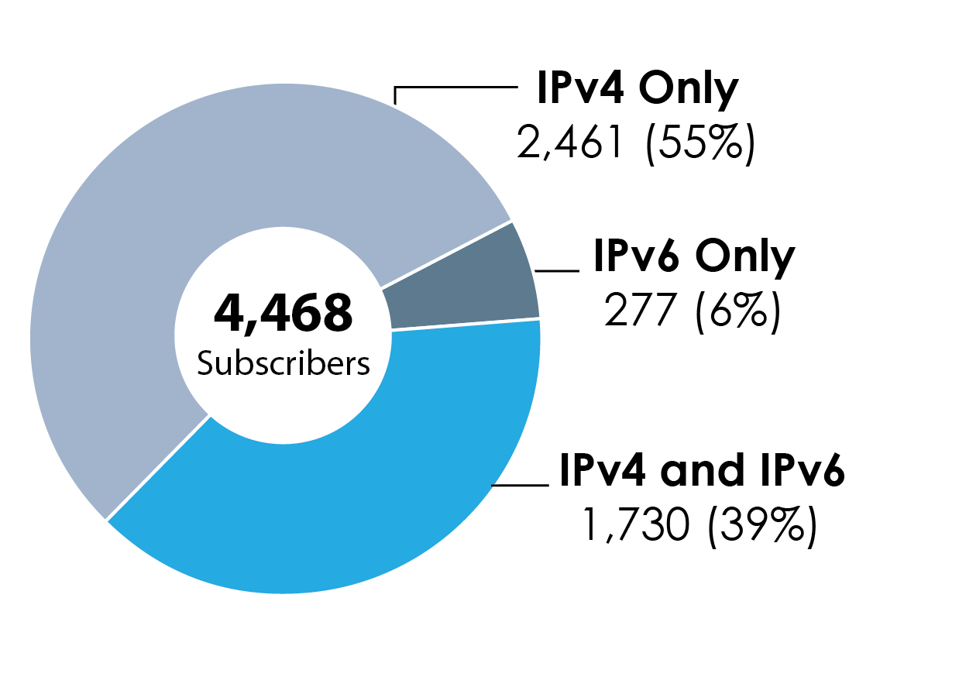
IPv4 vs IPv6 Subscribers
Notes:
The IPv4 and IPv6 band continues to grow a percent or two every year.
Why IPv6 only? Legacy IPv4 holders who obtained membership via IPv6 allocations.

Slide 8
8.3 (Specified) & 8.4 (Inter-RIR) Transfers
*18 networks transferred from ARIN to APNIC region to date
https://www.arin.net/knowledge/statistics/transfers.html

Slide 9
Policy Proposals
ARIN-2013-4: RIR Principles
ARIN-2013-6: Allocation of IPv4 and IPv6 Address Space to Out-of-region Requestors
ARIN-2013-7: Merge IPv4 ISP and End-User Requirements
https://www.arin.net/policy/proposals/
Notes:
Draft Policy ARIN-2013-4: RIR Principles
Would add principles such as reservation, conservation and routability from RFC 2050 to
ARIN number policy.
Draft Policy ARIN-2013-6: Allocation of IPv4 and IPv6 Address Space
to Out-of-region Requestors
Current proposal text says in order for an organization to get address
space from ARIN, the organization must have a ”plurality of their technical
infrastructure and customers in the designated ARIN region".
Draft Policy ARIN-2013-7: Merge IPv4 ISP and End-User Requirements
Would remove the differentiation between end users and ISPs for
requests for IPv4 space.

Slide 10
Public Facing Development Efforts
Accomplishments
Hosted RPKI since Sep 2012
15 Orgs as of 2/11/13
41 ROA's as of 2/11/13
61 Relying Parties
Web-based Delegated RPKI as of 2/16/2013
Integrated Payments
Extended Statistics Reports now consistent with other RIR's
Fee Calculator
Automated Invoicing
Upcoming Near-term Work
Up/Down RPKI Interface – Deployed 7 Sep 2013
Oracle to Postgres Conversion – Underway
Automating Transfers

Slide 11
Upcoming ARIN Meetings
NANOG 60
Atlanta, Georgia
10-12 Feb. 2014
Notes:
ARIN PPC at NANOG 60 in Feb 2014
ARIN 33 in Chicago in April 2014

